Slide 1
MapReduce
Pravin Y Pawar

Slide 2
Traditional Word Count
Objective : Count the occurrences of each word in a file
doWordCount(File file)
Define a structure hashMap <word, count> //key-value pair
For each line in file
Split the line into words
For each word in words
If the word is present in the hashamp
Increment the count by 1
Else
Add a new <word,1> pair into the hashMap
Output(hashMap)
Books.txt
Hadoop Definitive Guide
Hadoop in Action
Map Reduce Design Patterns

Slide 3
MapReduce Word Count
Objective : Count the occurrences of each word in a file
Split the file into n blocks – each block containing one line
Map(key : line_no, value : line)
split the line into words
for each word in words
output(word, 1) // key : word , value : 1
Arrange the key : value pairs by key’s
Reduce(key : word, value : value_list[])
count = 0
For each value in value_list
count = count + value
Output(word, count)
Books.txt
Hadoop Definitive Guide
Hadoop in Action
Map Reduce Design Patterns

Slide 4
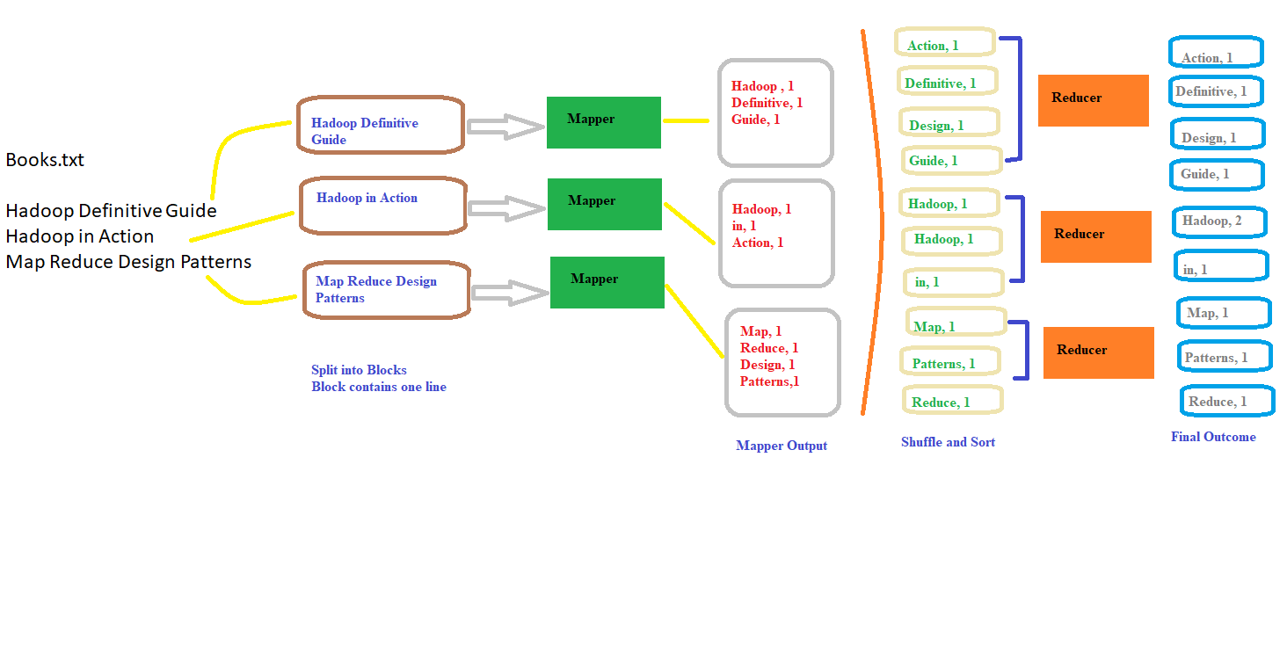
MapReduce Word Count (2)
Visually

Slide 5
Another MapReduce Example
Objective : Find the maximum temperature for each city
Three different files , each one containing the lines wrt City and temp
Assume each file = one block
Pass each file to a different mapper
Map (key : file_name, value : file)
For each line in the file
extract out the city and temp value
output(city, temp_value) // key : city , value : temp_value
Arrange the key : value pairs by key’s
Reduce(key : city, value : temp_value_list[])
Max_temp = temp_value_list[0]
For each temp_value in temp_value_list
if temp_value > Max_temp :
Max_temp = temp
Output(city, Max_temp)
Jan_Temp.txt
Mumbai , 31
Pune, 28
Delhi, 23
Feb_Temp.txt
Mumbai , 35
Pune, 34
Delhi, 29
March_Temp.txt
Mumbai , 25
Pune, 23
Delhi, 20

Slide 6
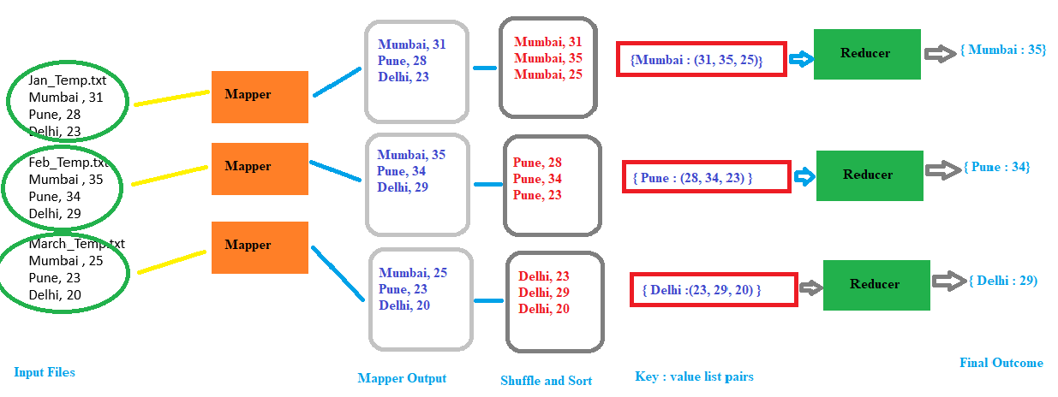
Another MapReduce Example(2)

Slide 7
Thank You!
Reference :
Big Data and Analytics by Acharya, Chellappan
In our next session: MapReduce Working

